Slide 1


SVA-Concord
Dr Rashmi R Borah
Assistant Professor of English
School of Social Sciences & Languages
VIT ,Chennai
rashmirekha.borah@vit.ac.in

Slide 2
Subject Verb Agreement
sentence must have a subject and a verb
A subject is a noun or pronoun.
A verb is the action performed by the subject.
subject and the verb must agree (or match) in number

Slide 3
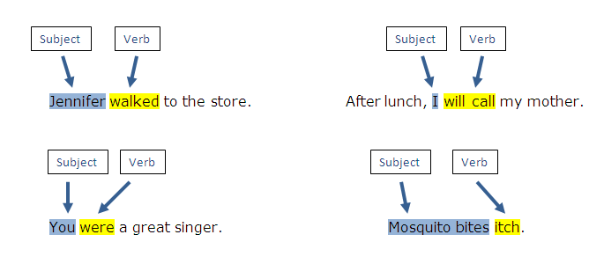

Slide 4
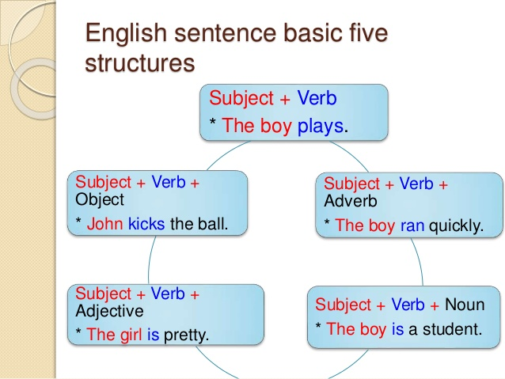

Slide 5
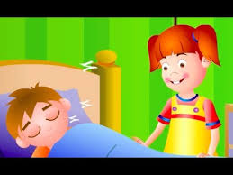

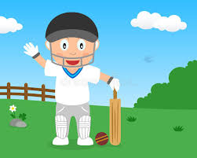
Venkat sleeps.
Venkat loves mango.
Venkat plays cricket.

Slide 6


1. Subjects and verbs must agree in number.
Singular subject = singular verb
Plural subject = plural verb
Cow= singular, eats= singular
Ducks= plural, quack= plural
*Hint*= SVS- singular verbs have an S
Singular yes?- the verb has an “S”!
Singular no? The “S” has to go!

Slide 7

2. Don’t get confused by the words that come between the subject and verb.
The detective who was called to the case is usually very good.

Slide 8


3. Prepositional phrases between the subject and verb usually do not affect the agreement.
The biker in this race is very competitive.
The bikers in this race are very competitive.

Slide 9


4. If a sentence starts with “there” or “ here”, the subject will always be placed after the verb.
There is a meeting today.
Here are the results from this past month.

Slide 10


5. Subjects can come after the verb in questions.
Does Betty always play with dolls?
How are the Bosco sticks today?

Slide 11

6. If two subjects are joined by “and”, they typically require a plural verb.
The puppy and the lady are friends.

Slide 12

7. If two subjects are separated by “and” refer to the same thing, the verb is singular.
Spaghetti and meatballs is my favorite pasta dish.

Slide 13



8. If both subjects are singular and connected by or, nor, neither/nor, either/or and not only/but also, the verb is singular.
Karthik or Swamy has stolen the scarecrow.
Not only the guitar player but also the drummer was soaked with sweat.

Slide 14

9. If both subjects are plural and connected by the words or, nor, neither/nor, either/or, and not only/but also, the verb is plural.
Cookies or brownies are nice treats for your teacher.

Slide 15


10. If one subject is singular and one plural and are connected by the words or, nor, neither/nor, either/or, and not only/but also, use the subject that is nearest the verb.
Either my sisters or my mom has sent me a present.
Not only Bob but also the Smiths want some hamburgers for supper.

Slide 16



11. Units of measurement usually use a singular verb.
Six gallons of paint was used on the house.
Five dollars is too much for a cup of coffee.

Slide 17
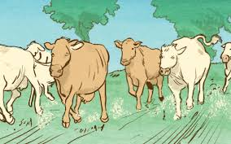

12. Collective nouns usually take a singular verb.
The herd is stampeding.
The class was ready for the test.

Slide 18
13. Titles of books, movies, novels, etc. are treated as singular.
Holes was one of my favorite books.I want to see the movie.

Slide 19


14. Two infinitives separated by and take a plural verb.
To run and to read are my two favorite “Free-time” activities.

Slide 20

15. Gerunds alone take a singular verb. Gerunds linked by and take a plural verb.
Dancing is not something everyone can do as well as I can!
Dancing and singing come naturally to me!

Slide 21


16. If the words each, every or no come before the subject, the verb is singular.
Each boy and girl has to take the test.
Every frog and toad turns into a prince.
No paper and pen is required.
(But an apple would be nice!:)

Slide 22


17. Most indefinite pronouns take singular verbs.
one | body | thing
someone | somebody | something
anyone | anybody | anything
No one | nobody | nothing
everyone | everybody | everything
Little One * Everybody is happy.
Another Neither * No one has a dime.
Much Either * Nothing was going to help.
Each

Slide 23
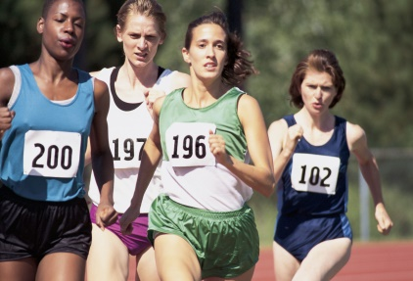

18. Both, a few,few, many, others, and several take a plural verb.
Several need to finish the race.
A few have the right answer.

Slide 24
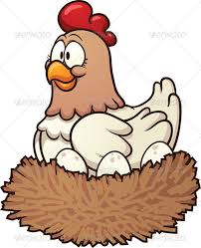
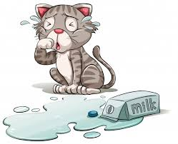
19. When the subject is all, any, more, most, none, or some, this is the ONLY time you must look at the object of the prepositional phrase to determine whether it is singular or plural.
All of the chickens have laid eggs.
Some of the milk has spilled.

Slide 25
Final rule- Remember, only the SUBJECT affects the verb!

Slide 26
Source
Wren and Martin.1935. High School English Grammar and Composition. Revised by NDV Prasad Rao.BLACKIE ELT Books(An imprint of S.Chand Publishing).India.

